Slide 1
Remaking China
Chapter 24

Slide 2
End of the Monarchy

Slide 3
The End of the Monarchy
Dynasty faced Financial Crisis
Boxer Protocol of 1901
450 million silver dollars
Twice the annual revenue
Paid out of customs revenue
Little left for ordinary government operation

Slide 4
Local Activism
Local elites took on modernization projects
Schools and magazines
Asked question “How did West and Japan gain power”
Yan Fu
Sent to England to study Naval Techniques
Extremely influential translations
Show that Western wealth and power does not lie with technology but with ideas and institution behind the technology
Western Learning needed, rejected Chinese traditions – but argued for gradual change
Notes:
Sent to England to study Naval Techniques
Extremely influential translations
Show that Western wealth and power does not lie with technology but with ideas and institution behind the technology
Western Learning needed, rejected Chinese traditions – but argued for gradual change
Yen Fu
born Jan. 8, 1854, Fu-chou, Fukien province, China died Oct. 27, 1921, China Pinyin Yan Fu Chinese scholar who translated into Chinese works by T.H. Huxley, J.S. Mill, Herbert Spencer, Adam Smith, and others in an attempt to show that the secret to Western wealth and power did not lie in Western technological advances, such as gunmaking, but in the ideas and institutions that lay behind these techniques.
Yen Fu was sent to England to study naval techniques, but he soon became interested in British government, jurisprudence, economics, and sociology. He returned to China in 1879. China's humiliating defeat by Japan in 1895 prompted him to advocate liberal social and political reform. He did so because he detected in liberal institutions a way of strengthening the state. His understanding of Darwinism convinced him that change must come through a gradual shift in the thought of the Chinese elite, not from revolution. In the chaotic years after the Revolution of 1911, he opposed republicanism in China and supported Yüan Shih-k'ai in his attempt to restore the monarchy. In his late years, Yen Fu rejected his earlier position regarding Western thought and turned increasingly to Confucianism and ancient Chinese culture.
Yen Fu wrote poetry in addition to his translations; two collections of his poetry were published posthumously.
Additional Reading
Benjamin Schwartz, In Search of Wealth and Power: Yen Fu and the West (1964).
" Yen Fu ." Encyclopædia Britannica. 2006. Encyclopædia Britannica Premium Service. 3 Apr. 2006 <http://www.britannica.com/eb/article-9077926>.

Slide 5
Local Activism
Immigration restrictions & Mistreatment of Chinese in America leads to boycotts of the United States
Chinese students study in Japan
increases nationalistic feelings
Kang Youwei and Liang Qichao promote modernization from Japan
Notes:
Ever since the passage in the United States of the 1882 anti-Chinese exclusion laws and their enforced ratification by treaty, Americans have performed numerous hostile acts against Chinese immigrants. Immigration officers of the United States Treasury Department broke into Chinese homes in American cities allegedly to check registrations; harassments and deportations were common; and Chinese arriving at United States ports-including visitors of high status such as the delegations coming by invitation to the St. Louis exposition in 1904-were roughly handled and abused. Further bitterness developed when America’s exclusionary policies were extended to Chinese residing in Hawaii and the Philippines. (Jonathan D. Spence, the search for modern China, page 235.)

Slide 6
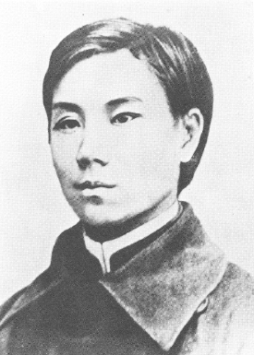
Anti-Manchu Revolutionary Movement
Zou Rong (1885-1905) – Revolutionary thinker and activist in the late Qing
Radicalized as a student in Japan; introduced to concepts such as nationalism, democracy, and anti-imperialism
Publication of The Revolutionary Army
Ideas of nationalism and republicanism
Called for Armed Revolution
Social Darwinism –
Seemed to many to describe China’s plight
Arrested and Executed at age of 20
Notes:
Zuo Rong (1885–1905) was a revolutionary thinker and activist in late Qing China. His life and writings significantly influenced the anti-Manchu revolutionary movement, which sought to overthrow the Qing dynasty and establish a Han-led republic.
Background and Early Life
Zuo Rong was born in Sichuan province. He studied in Japan, where many Chinese intellectuals of the time were exposed to new ideas, including nationalism, democracy, and anti-imperialism. In Japan, Zuo came under the influence of reformist and revolutionary currents, which shaped his political thought.
Key Contributions:
Publication of The Revolutionary Army (革命軍, Geming Jun): Zuo Rong is best known for this incendiary pamphlet, published in 1903. In this work, he argued for the violent overthrow of the Qing dynasty, calling the Manchus a foreign oppressor ruling over the Han Chinese. He linked the Manchu rulers with China's humiliation at the hands of Western imperialist powers.
Ideas of Nationalism and Republicanism: Zuo Rong was heavily influenced by Western political ideals and the writings of Sun Yat-sen, advocating for the creation of a modern republic. He emphasized the importance of racial and national unity and saw the Manchus as a barrier to China's modernization and sovereignty.
Call for Armed Revolution: Zuo believed that peaceful reform was futile and that only armed resistance could bring about the necessary political change. His rhetoric was unapologetically militant, making him one of the more radical voices in the anti-Manchu movement.
Impact on the Revolutionary Movement:
Zuo's ideas were highly influential among revolutionary groups such as the Tongmenghui (United League), founded by Sun Yat-sen in 1905.
His writings inspired a generation of young revolutionaries committed to overthrowing the Qing dynasty.
Early Death:
Zuo Rong’s revolutionary activities attracted the attention of the Qing authorities. He was arrested and imprisoned, where he died in 1905 at the young age of 20. Despite his short life, his legacy endured, and he was celebrated as a martyr in the later Republic of China.
Legacy:
Zuo Rong remains an iconic figure in Chinese revolutionary history. His work helped lay the ideological groundwork for the 1911 Revolution, which ultimately toppled the Qing dynasty and ended over two millennia of imperial rule in China.

Slide 7


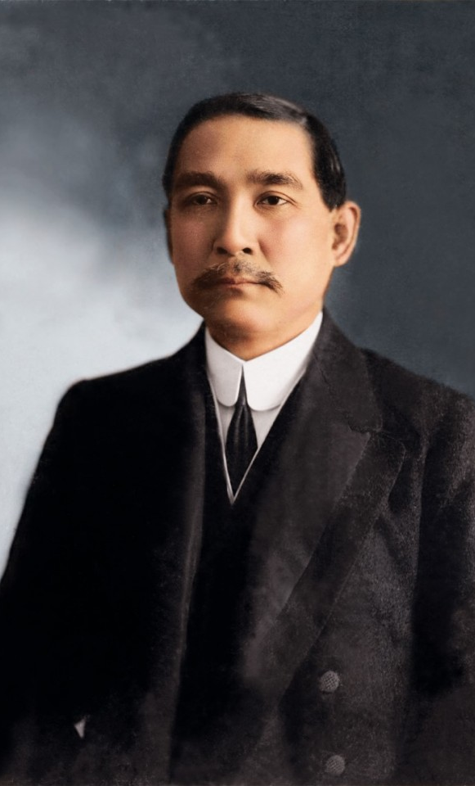



Sun Yatsen: Father of Modern China
Educated in Hawaii and Hong Kong
Completed medical degree in 1882
Founded Revive China Society in 1894
First Uprising Attempt in Guangzhou
Unsuccessful, forced into exile
Spent years abroad raising funds and support from overseas Chinese
Formation of the Tongmenghui
United various revolutionary groups
Notes:
Revolutionary Career
Founding of the Revive China Society (興中會)
Established in 1894 in Hawaii, this organization aimed to overthrow the Qing dynasty and modernize China.
It marked the beginning of Sun’s formal revolutionary activities.
First Uprising Attempt (1895)
Sun led an unsuccessful revolt in Guangzhou, which forced him into exile.
He spent years abroad, raising funds and support for the revolutionary cause from overseas Chinese communities.
Formation of the Tongmenghui (同盟會)
In 1905, Sun founded the United League (Tongmenghui) in Tokyo, uniting various revolutionary groups.
The Tongmenghui became the precursor to the Nationalist Party (Kuomintang, or KMT).

Slide 8
Three Principles of the People
Nationalism
Opposition to Manchu and foreign imperialism
Self-determination for the Chinese people as a whole, including minority groups in China
Democracy
Establish a republican government based on democratic principles
People’s livelihood
Implement social reforms, including land redistribution and economic equality.
Both Mao Zedong and Chiang Kai-shek claimed to be carrying on true spirit of Three Principles.
Notes:
Three Principles of the People
Encyclopædia Britannica Article
Three Principles of the People
also called Three Great Principles, Chinese (Wade–Giles) San Min Chu-i, or (Pinyin) San Min Zhuyi, the ideological basis of the political program of the Chinese national leader Sun Yat-sen (1866–1925), championing the principles of nationalism, democracy, and socialism.
The principles were originally formulated as slogans for Sun's revolutionary student group, the United League, one of the chief forces behind the 1911 Republican Revolution, which ended the Manchu rule of China. After the failure of this revolution to establish democracy in China, Sun formed a new party, the Kuomintang, or Nationalist Party, utilizing his principles as fundamental doctrine. In 1922 the Kuomintang formed an alliance with the Chinese Communist Party. The following winter, Sun, in response to Communist demands for a more formal party ideology, gave a series of lectures in which he sharpened and defined his three principles.
The first principle, min-tsu chu-i, or nationalism, earlier had meant opposition to the Ch'ing (Manchu) dynasty and to foreign imperialism; now Sun explained the phrase as denoting self-determination for the Chinese people as a whole and also for the minority groups within China. The second principle, min-ch'üan chu-i, or the “rights of the people,” sometimes translated as “democracy,” could be achieved, Sun explained, by allowing the Chinese people to control their own government through such devices as election, initiative, referendum, and recall. The last principle was min-sheng chu-i, or “people's livelihood,” which is often translated as “socialism.” This is the most vague of the three proposals, but by it Sun seemed to have in mind the idea of equalization of land ownership through a just system of taxation.
After the Kuomintang-Communist split in 1927, both Mao Zedong and Chiang Kai-shek claimed to be carrying on the true spirit of the Three Principles of the People.
Three Principles of the People (三民主義)
Sun’s political philosophy, known as the Three Principles of the People, became the foundation of his revolutionary vision:
Nationalism (民族):
Expel the Manchu rulers and resist foreign domination to achieve national sovereignty.
Democracy (民權):
Establish a republican government based on democratic principles.
People’s Livelihood (民生):
Implement social reforms, including land redistribution and economic equality.

Slide 9
Social Darwinism and Chinese Revolutionary Thought
Perception of China's Weakness
By the late 19th century, China faced repeated defeats in conflicts like the Opium Wars and the Sino-Japanese War (1894-1895).
These defeats led to a belief that China was "unfit" in a world dominated by stronger imperialist powers.
Call for National Survival
Revolutionaries argued that the Qing dynasty's failure to modernize had made China vulnerable to foreign domination.
Social Darwinism framed the fight against the Qing as a struggle for national survival and progress.

Slide 10
Manchu Reform Movement
External and Internal Pressures finally forced the Qing to act
To modernize and strengthen the Qing state while maintaining the monarchy.

Slide 11
Manchu Reform Movement
Political Reforms
The Qing promised to establish a constitutional monarchy.
Provincial assemblies were established in 1909, and a national assembly was planned.
Military Reforms
Reorganization and modernization of the army, modeled on Western and Japanese forces.
The creation of the New Army (新军), which aimed to build a modern, loyal military force.
Creation of Military Academy
Notes:
Political Reforms
Constitutional Reform:
The Qing promised to establish a constitutional monarchy.
The 1908 Constitution Outline laid the groundwork for parliamentary government.
Provincial assemblies were established in 1909, and a national assembly was planned.
Military Reforms
Reorganization and modernization of the army, modeled on Western and Japanese forces.
The creation of the New Army (新军), which aimed to build a modern, loyal military force.
Educational Reforms
Abolition of the imperial examination system in 1905.
Establishment of modern schools and promotion of Western-style education.
Sending students abroad to study in Japan and Europe.
Economic Reforms
Efforts to modernize infrastructure, such as railways and communication systems.
Creation of state-owned enterprises and banking reforms.
Initiatives to industrialize China and reduce reliance on foreign powers.

Slide 12
Manchu Reform Movement
Educational Reforms
Abolition of the imperial examination system in 1905.
Establishment of modern schools and promotion of Western-style education.
Sending students abroad to study in Japan and Europe.
Economic Reforms
Efforts to modernize infrastructure, such as railways and communication systems.
Creation of state-owned enterprises and banking reforms.
Initiatives to industrialize China and reduce reliance on foreign powers.
Notes:
Political Reforms
Constitutional Reform:
The Qing promised to establish a constitutional monarchy.
The 1908 Constitution Outline laid the groundwork for parliamentary government.
Provincial assemblies were established in 1909, and a national assembly was planned.
Military Reforms
Reorganization and modernization of the army, modeled on Western and Japanese forces.
The creation of the New Army (新军), which aimed to build a modern, loyal military force.
Educational Reforms
Abolition of the imperial examination system in 1905.
Establishment of modern schools and promotion of Western-style education.
Sending students abroad to study in Japan and Europe.
Economic Reforms
Efforts to modernize infrastructure, such as railways and communication systems.
Creation of state-owned enterprises and banking reforms.
Initiatives to industrialize China and reduce reliance on foreign powers.

Slide 13
Manchu Reform Movement
Reforms ironically often made situation worse
Education:
Modern schools and studies abroad introduced Chinese to western ideas, esp. nationalism
Government:
establishment of constitution with elected assembly – becomes centers of opposition
Military:
conscript army influenced by new ideas or loyal to commander rather than throne; Yuan Shikai commander of new army

Slide 14
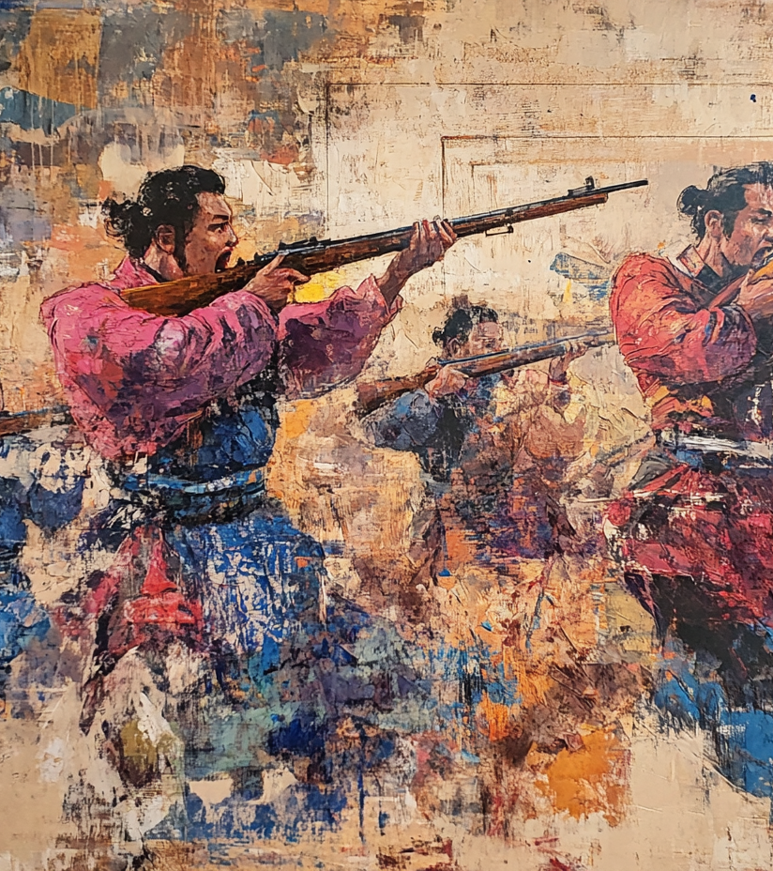
Revolution of 1911
Wuchang Uprising (Oct 10, 1911)
Bomb accidently explodes at headquarters of revolutionary group; police find lists of revolutionaries, including army officers
Forced rebels to act prematurely
Takes over city in less than a day
Spread of Revolution; within weeks 15 Provinces declare independence
Puyi abdicates on Feb 2, 1912
Allowed to remain in the forbidden city and keep property
Notes:
Chinese Revolution
Encyclopædia Britannica Article
Chinese Revolution
(1911–12), nationalist revolt that overthrew the Ch'ing, or Manchu, dynasty in 1912 and created a republic.
Ever since their conquest of China in the 17th century, most of the Manchus had lived in comparative idleness, supposedly a standing army of occupation but in reality inefficient pensionaries. All through the 19th century the dynasty had been declining, and upon the death of the Empress Dowager (1908) it lost its last able leader. In 1911 the Emperor was an infant, and the regency was incompetent to guide the nation. The unsuccessful contests with foreign powers had shaken not only the dynasty but the entire machinery of government.
The chain of events immediately leading to the revolution began when an agreement was signed (April 5, 1911) with a four-power group of foreign bankers for the construction of lines on the Hukwang Railway in central China. The Peking government decided to take over from a local company a line in Szechwan, on which construction had been barely begun, and to apply part of the loan to its completion. The sum offered did not meet the demands of the stockholders, and in September 1911 the dissatisfaction boiled over into open revolt. On October 10, in consequence of the uncovering of a plot in Hankow that had little or no connection with the Szechwan episode, a mutiny broke out among the troops in Wu-ch'ang, and this is regarded as the formal beginning of the revolution. The mutineers soon captured the Wu-ch'ang mint and arsenal, and city after city declared against the Manchus. The regent, panic-stricken, granted the assembly's demand for the immediate adoption of a constitution and urged a former viceroy, Yüan Shih-k'ai, to come out of retirement and save the dynasty. In November he was made premier.
Had Yüan acted vigorously he might have suppressed the uprising and so have delayed the inevitable. He dallied, however, and by the end of the year 14 provinces had declared against the Manchus. In several cities Manchu garrisons had been massacred, the regent had been forced out of office, a provisional republican government had been set up at Nanking, and the archrevolutionist Sun Yat-sen had returned from abroad and had been elected president.
In December Yüan agreed to an armistice and entered upon negotiations with the republicans. On Feb. 12, 1912, the boy emperor was made to abdicate the throne in a proclamation that transferred the government to the people's representatives, declared that the constitution should thenceforth be republican, and gave Yüan Shih-k'ai full powers to organize a provisional government. The Nanking authorities agreed that the Emperor was to retain his title for life and to receive a large pension. To unify the country, Sun Yat-sen resigned the presidency, and Yüan was chosen in his place. Li Yüan-hung, who had come into prominence in Wu-ch'ang in the initial stages of the rebellion, was elected vice president. A provisional constitution was promulgated in March 1912 by the Nanking parliament, and in April the government was transferred to Peking.
The republic, established with such startling rapidity and comparative ease, was destined in the succeeding decades to witness the progressive collapse of national unity and orderly government.
To cite this page:
MLA style:
" Chinese Revolution ." Encyclopædia Britannica. 2006. Encyclopædia Britannica Premium Service. 3 Apr. 2006 <http://www.britannica.com/eb/article-9082149>.
APA style:
Chinese Revolution . (2006). Encyclopædia Britannica. Retrieved April 3, 2006, from Encyclopædia Britannica Premium Servicehttp://www.britannica.com/eb/article-9082149
Britannica style:
" Chinese Revolution ." Encyclopædia Britannica from Encyclopædia Britannica Premium Service. <http://www.britannica.com/eb/article-9082149> [Accessed April 3, 2006].
Back to top

Slide 15
Provisional Government
Sun Yat-sen was appointed as the first provisional president of the Republic of China on January 1, 1912, in Nanjing.
To avoid civil war, Sun ceded the presidency to Yuan Shikai, a Qing general, in exchange for Yuan's support in securing the emperor's abdication.

Slide 16
The Presidency of Yuan Shikai and the Emergence of the Warlords

Slide 17
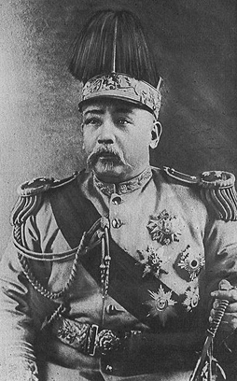
Presidency of Yuan Shikai
Accepted presidency; quickly develops into a dictator
ordered assassination of Song Jiaoren
Accepted foreign loans without consulting national assembly; antagonized reformers more
Second Revolution
Easily routed
Sun Yat-sen forced into exile in Japan
Abolished all assemblies
Notes:
Yüan Shih-k'ai
Encyclopædia Britannica Article
Yüan Shih-k'ai
born 1859, Honan province, China died June 6, 1916
Pinyin Yuan Shikai , literary name Jung-an Chinese army leader and reformist minister in the twilight of the Manchu (Ch'ing) dynasty (until 1911) and then first president of the Republic of China (1912–16).
Yüan was from a landed military family of Hsiang-ch'eng in Honan province. In his youth he showed a propensity for pleasure-seeking and excelled in physical activity rather than scholarship, although he was obviously a man of remarkable astuteness. He failed to win even the lowest of the classical degrees but was to have the distinction of being the first Han Chinese to hold a viceroyalty and to become a grand councillor without any academic qualification. In the last days of the empire, he was made a marquess.
Yüan began his career in the Ch'ing brigade of the Anhwei army, commanded by Li Hung-chang, which was dispatched to Korea in 1882 to try to prevent Japanese encroachment in the area. The political crises of that remote kingdom repeatedly offered him opportunities to prove the correctness of his judgment and the promptness of his action, especially in military and economic affairs. In 1885 he was made Chinese commissioner at Seoul, and his energetic and loyal service to the throne contributed to the outbreak of the Sino-Japanese War of 1894–95.
With the destruction of China's navy and army by Japan in the war, Peking was exposed to external and internal attack; in consequence, the training of a new army became an urgent task that fell on Yüan. As the division under his command was the only remnant of China's army that survived the Boxer Rebellion of 1900, Yüan's political stature became greater than that of all others, and in 1901 he was given the viceroyalty of the metropolitan province. In that office, and later as a grand councillor, he was to play a decisive part in China's modernization and defense programs; throughout, he enjoyed the trust and unflinching support of the dowager empress, Tz'u-hsi. On the death of the empress (1908), his opponents, notably the regent for the infant emperor, stripped him of all his offices and sent him home. Nevertheless, when the tide of revolution threatened to engulf the Manchu dynasty, the throne was to need his service once more.
At this critical juncture, Yüan appeared to conservatives and revolutionaries alike as the only man who could lead the country to peace and unity; and so both the emperor in Peking and the provisional president in Nanking recommended Yüan to be the first president of China. The treasury then was empty; the provinces were in the hands of local war lords; a permanent constitution was still in the making; and the newly elected National Assembly was, to Yüan, too quarrelsome and too cumbersome for the good of the country. When his plan for a gigantic foreign loan was obstructed by the Nationalist Party (Kuomintang) in the National Assembly, he ruthlessly murdered the chairman of the party and undermined the assembly, thus bringing about the revolt against him in 1913. His victory in that struggle marked the end of all hopes for parliamentary democracy in China. Thereafter, he contrived to make himself president for life and then boldly tried to create a new imperial dynasty in 1915–16. Though his aim was to unite the country and to strengthen its central leadership, Yüan's last attempt, ironically, sowed dissension even among the conservative civilian and military forces that had supported him. Widespread opposition, backed by Japan, rose to challenge his authority. Yüan found his European friends preoccupied by World War I and his old lieutenants unwilling to fight.
Jerome Ch'en
Additional Reading
For a comprehensive study of the life and times of Yüan Shih-k'ai, see Jerome Ch'en, Yüan Shih-k'ai: Brutus Assumes the Purple, 2nd ed. (1972), which includes an extensive bibliography. Other accounts that provide information on the role of Yüan Shih-k'ai in revolutionary events are Harold Schiffrin, Sun Yat-sen and the Origins of the Chinese Revolution (1968); and E.P. Young, Presidency of Yüan Shih-k'ai (1977).
To cite this page:
MLA style:
" Yüan Shih-k'ai ." Encyclopædia Britannica. 2006. Encyclopædia Britannica Premium Service. 5 Apr. 2006 <http://www.britannica.com/eb/article-9078112>.
APA style:
Yüan Shih-k'ai . (2006). Encyclopædia Britannica. Retrieved April 5, 2006, from Encyclopædia Britannica Premium Servicehttp://www.britannica.com/eb/article-9078112
Britannica style:
" Yüan Shih-k'ai ." Encyclopædia Britannica from Encyclopædia Britannica Premium Service. <http://www.britannica.com/eb/article-9078112> [Accessed April 5, 2006].
Background of the Assassination:
Song Jiaoren's Role: Song Jiaoren was a charismatic leader who played a pivotal role in organizing the Kuomintang and securing a majority in the first parliamentary elections of the Republic of China.
Conflict with Yuan Shikai: Song was an advocate for parliamentary democracy and openly opposed Yuan's authoritarian tendencies. He aimed to limit Yuan's power as president.
Assassination: Song was shot on March 20, 1913, at the Shanghai train station and died two days later. The assassination occurred just as he was preparing to take a leading role in the newly formed parliament.
Connection to Yuan Shikai: Evidence strongly suggested that Yuan or his close associates orchestrated the assassination to eliminate Song as a political rival. However, direct proof of Yuan's involvement was never conclusively established.
The assassination of Song Jiaoren was a turning point in the early Republic of China. It fueled widespread outrage and contributed to the Second Revolution, an unsuccessful attempt by the Kuomintang to overthrow Yuan Shikai, who consolidated power and later declared himself emperor in 1915.

Slide 18
Twenty-One Demands
With Western nations pre-occupied by WWI, Japan imposes demands on China
Concessions in rail, mining, territory
Access to harbors, bays, and islands
Japanese control, through advisors, of Chinese financial, political, and police affairs (essentially becoming a protectorate)
Yuan forced to accept all but last of Japans demands
Leaked publically; Wave of anti-Japanese protests and boycotts
Notes:
Twenty-one Demands
(Jan. 18, 1915), claims made by the Japanese government to special privileges in China during World War I. The major European powers, which already enjoyed similar privileges in China, could not oppose Japan's move because of their involvement in the war. On May 7 Japan delivered an ultimatum, to which the Chinese president, Yüan Shih-k'ai, capitulated by signing a series of Sino-Japanese agreements on May 25.
The demands called for confirmation of Japan's railway and mining claims in Shantung Province; granting of special concessions in Manchuria; Sino-Japanese control of the Han-Yeh-P'ing mining base in central China; access to harbours, bays, and islands along China's coast; and Japanese control, through advisers, of Chinese financial, political, and police affairs. Yüan's forced acceptance of all but the last point greatly increased anti-Japanese feeling in China.
To cite this page:
MLA style: " Twenty-one Demands ." Encyclopædia Britannica. 2008. Encyclopædia Britannica Online. 14 2008 <http://www.britannica.com/eb/article-9073947>.
APA style: Twenty-one Demands . ( 2008). In Encyclopædia Britannica. Retrieved 14, 2008, from Encyclopædia Britannica Online: http://www.britannica.com/eb/article-9073947

Slide 19
Imperial Restoration
Yuan consolidated power, sidelined democratic institutions, and ruled as an authoritarian leader.
Yuan takes steps to proclaim himself emperor
New Dynasty proclaimed December 1915
Strong opposition
Seen as betrayal of 1911 Revolution
Provinces begin declaring independence
Yuan rescinds claim to throne March 22, 1916
Dead by June 1916; rumors of poisoning

Slide 20
Warlord Era
Military commanders of Chinese provinces built independent power bases
Yuan Shikai’s use of military power (rather than parliamentary methods) set stage for warlord era; many warlords were officers under Yuan
Outer regions declared independence
Waged highly destructive wars
Balance of power maintained; few able to extend power beyond province
Conditions varied widely
Notes:
warlord
Encyclopædia Britannica Article
warlord
Wade–Giles romanization tu-chün , Pinyin dujun independent military commander in China in the early and mid-20th century. Warlords ruled various parts of the country following the death of Yüan Shih-k'ai (1859–1916), who had served as the first president of the Republic of China from 1912 to 1916. Yüan's power had come from his position as head of the Peiyang Army, which was the only major modern military force in China at the time. His conduct of the government through a reliance upon military power rather than parliamentary methods made him the “father of the warlords”; at least 10 of the major warlords that came to power in the 1920s had originally served as officers in his Peiyang Army. The other warlords achieved power through the backing either of various provincial military interests or of foreign powers, most notably Japan but also Britain and the Soviet Union.
New factions and alliances constantly ensured that no one warlord ever became powerful enough to destroy all the rest. As a result, few warlords were able to extend their power over more than one or two provinces. Nevertheless, a major cleavage developed between warlord groups in North China and those in the South.
The South was the heartland of Chinese Republican spirit and nationalistic feeling. In 1921 the great nationalist leader Sun Yat-sen established an independent revolutionary regime under the control of his Nationalist Party (Kuomintang) at the South China city of Canton. This regime soon came to exercise a preeminent position among the squabbling southern warlords.
In the North, conditions were quite different. There, three leading personalities emerged in the early 1920s: Chang Tso-lin, a former bandit based in Manchuria who, with Japanese support, came to control that northeastern region's three provinces; Wu P'ei-fu, a traditionally educated former Peiyang officer who tried to establish order in central China; and Feng Yü-hsiang, the “Christian General” (he baptized his troops with fire hoses), who seized Peking in 1924 and destroyed the facade of parliamentary government and a unified China that had been presented by the capital.
Meanwhile, Sun Yat-sen received aid from the small Chinese Communist Party and the Soviet Union to build the Republican Army, through which the Nationalist Party consolidated its control in the South. Sun died in 1925, but the next year Nationalist forces under Chiang Kai-shek swept northward and in 1928 reunified China, abolishing the separate warlord regimes. Chiang, however, did not really eliminate the warlords, but rather, by means of alliances, incorporated many of them into his army. Local warlords continued to exert de facto power over their own domains and to be a factor in Chinese politics until the establishment of the Communist government in 1949.
To cite this page:
MLA style:
" warlord ." Encyclopædia Britannica. 2006. Encyclopædia Britannica Premium Service. 5 Apr. 2006 <http://www.britannica.com/eb/article-9076115>.
APA style:
warlord . (2006). Encyclopædia Britannica. Retrieved April 5, 2006, from Encyclopædia Britannica Premium Servicehttp://www.britannica.com/eb/article-9076115
Britannica style:
" warlord ." Encyclopædia Britannica from Encyclopædia Britannica Premium Service. <http://www.britannica.com/eb/article-9076115> [Accessed April 5, 2006].
Back to top

Slide 21
Toward a more modern china

Slide 22
The New Culture Movement
response to traditional Chinese Confucian culture and values,
advocating for radical changes to modernize Chinese society in the face of national crises and growing foreign influence.
Rejection of Traditional Confucian Values
Promotion of Modern Values
Democracy, Science, Individualism, and Equality
Language Reform
Cultural Modernization
Inspired by Western philosophy, literature, and science
Notes:
Main Goals of the Movement:
Rejection of Traditional Confucian Values: The movement criticized Confucianism as a source of China's weakness and stagnation.
Promotion of Modern Values: Advocated for democracy, science, individualism, and equality (including gender equality).
Language Reform: Promoted the use of vernacular Chinese (白話文, báihuàwén) over classical Chinese (文言文, wényánwén) to make education and literature more accessible to the general public.
Cultural Modernization: Emphasized the importance of Western philosophy, literature, and science in shaping a modern Chinese society.

Slide 23
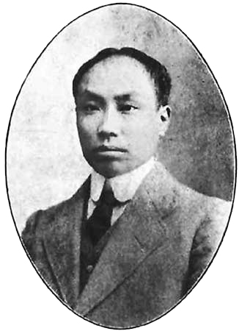
Chen Duxiu
Received classical education and passed civil service exam
Convinced of its irrelevance, he becomes a social and political reformer
Studied in Japan and France
Involved in Revolutionary activities
Publishes New Youth Magazine
Proposed youth of China undertake vast intellectual, literary, and cultural revolution
Rejects Confucianism and Confucian values
Notes:
http://www.britannica.com/biography/Chen-Duxiu

Slide 24
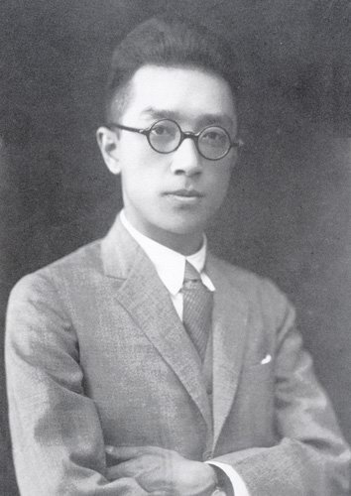
Hu Shi
Studied philosophy in the United States
Appointed to faculty of Beijing University
Championed use of vernacular
National literature would produce a standard dialect
New Youth magazine soon written entirely in vernacular Chinese
Use of vernacular became universal by the early 1920s

Slide 25
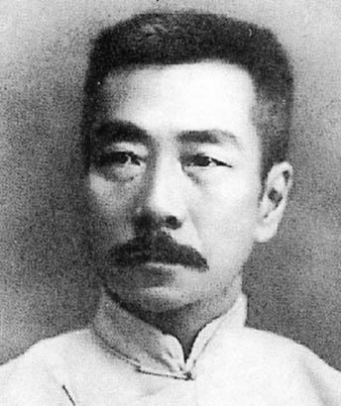
Lu Xun
Trained as a doctor in Japan
Gave up medicine; need to heal Chinese spirit more than to heal their bodies
“Diary of Madman” published in New Youth (Handout)
“The True Story of Ah Q”
Gave voice to those troubled about China’s prospects but weary of easy solution
Put blame for China’s problems on China’s own flaws
Notes:
"The True Story of Ah Q" (阿Q正传, Ā Q Zhèngzhuàn) is an influential novella by Chinese writer Lu Xun, first serialized between December 1921 and February 1922. It was later included in his 1923 collection Call to Arms (呐喊, Nàhǎn). This work is considered a cornerstone of modern Chinese literature, marking a significant shift toward the use of vernacular Chinese following the May Fourth Movement of 1919. Wikipedia
Plot Summary: The novella follows Ah Q, an impoverished and uneducated peasant in the fictional village of Weizhuang. Ah Q is characterized by his "spiritual victories," a coping mechanism where he convinces himself of triumph despite actual failures and humiliations. He often rationalizes his defeats as moral or spiritual successes, embodying a form of self-deception. Throughout the story, Ah Q experiences various misfortunes, including beatings, public ridicule, and unrequited romantic pursuits. His life culminates in his involvement in a failed revolutionary movement, leading to his unjust execution. Wikipedia
Themes and Significance: Lu Xun uses Ah Q's character to critique the Chinese national character of the time, particularly the tendency to avoid confronting reality and the propensity for self-deception. The term "Ah Q mentality" has since entered the Chinese lexicon, describing individuals who rationalize their failures as successes. The novella also addresses themes of social injustice, the flaws of human nature, and the ineffectiveness of superficial revolutionary changes. Wikipedia
Cultural Impact: "The True Story of Ah Q" has had a profound impact on Chinese culture and literature. It introduced the term "Ah Q-ism" to describe the rationalization of defeat as a "spiritual victory." The novella has been translated into multiple languages and adapted into various forms, including films, plays, and ballets. Its critique of societal flaws and exploration of human psychology continue to resonate, making it a subject of study and discussion in both literary and cultural contexts. Wikipedia
For a more detailed exploration, you can refer to the full text available at the Marxists Internet Archive: Marxists Internet Archive
Here’s a detailed plot summary of "The True Story of Ah Q" by Lu Xun:
Setting:
The novella is set in the fictional village of Weizhuang in rural China during the late Qing Dynasty and early Republican era. It portrays the socio-political changes in China during this turbulent period.
The Character of Ah Q:
Ah Q is an uneducated, impoverished peasant who is known for his distinctive "spiritual victories." Whenever he suffers humiliation or defeat, he convinces himself that he has achieved a moral or spiritual triumph, which helps him maintain his sense of superiority despite his low status. This self-delusion forms the core of his personality and drives much of the narrative.
Key Plot Points:
Ah Q’s Life in Weizhuang:
Ah Q is a drifter, with no steady job or family. He earns meager wages doing odd jobs.
He is often the target of ridicule and bullying by villagers, who see him as a convenient scapegoat.
Despite his lowly status, Ah Q looks down on others, including poorer villagers and women, reinforcing his self-delusion.
Encounters with the Villagers:
Ah Q frequently gets into conflicts, often suffering physical or verbal abuse.
In one instance, he is beaten by Mr. Zhao, a wealthy villager, but rationalizes it as a "spiritual victory," convincing himself that being slapped by someone of higher status is an honor.
He makes crude and misogynistic advances toward a nun, which leads to further humiliation when she rejects him and he is scolded by the villagers.
Failed Ambitions:
Ah Q dreams of improving his status. When he hears of revolutionary activities, he imagines joining them and becoming a great hero. However, his revolutionary aspirations are superficial and self-serving.
His involvement in the revolution is accidental and minimal; he follows others without understanding the larger political context.
Revolution and Downfall:
As the revolution sweeps through China, the local gentry are overthrown, and the social order in Weizhuang changes. Ah Q initially hopes the revolution will elevate his status.
Instead of becoming a revolutionary leader, he is scapegoated by the new regime for stealing and other crimes. The revolution does not bring the justice or change he imagined but replicates the same oppressive patterns.
Execution:
Ah Q is arrested, tried, and sentenced to death without a fair process. He does not fully comprehend the gravity of his situation.
On the day of his execution, Ah Q remains delusional, comforting himself with thoughts of being celebrated as a martyr. His last words reflect his enduring inability to grasp reality.
Themes Reflected in the Plot:
Critique of the Chinese National Character:
Ah Q's self-deception and passivity reflect Lu Xun's broader critique of the Chinese people's reluctance to face uncomfortable truths.
His rationalization of defeats as "spiritual victories" symbolizes a national failure to confront and overcome societal problems.
Social Hierarchy and Injustice:
The villagers exploit and humiliate Ah Q, reflecting the cruelty of a rigid social hierarchy.
The revolution, meant to bring justice, perpetuates the same injustices, showing Lu Xun’s skepticism toward superficial reforms.
Human Weakness:
Ah Q's flaws—his arrogance, delusions, and ignorance—mirror universal human weaknesses, making him both a tragic and satirical figure.
Ending:
Ah Q’s tragic execution underscores the futility of his life and the larger failures of the revolutionary promise. His death is both an individual tragedy and a reflection of a society unable to achieve meaningful change.
"The True Story of Ah Q" remains a powerful allegory of societal and individual failings, illustrating Lu Xun's sharp critique of early 20th-century China and human nature as a whole.
4o

Slide 26
China at Versailles
China in WWI
China declared war on Germany in 1917
140,000 Chinese laborers sent to Europe to support Allies
Treaty of Versailles
Territorial losses – German concessions given to Japan
Betrayal by the Allies
Humiliation
China refused to sign Treaty of Versailles
Notes:
China in World War I:
China declared war on Germany in 1917, hoping to reclaim the territories in Shandong Province that had been under German control since the late 19th century.
Over 140,000 Chinese laborers were sent to Europe to support the Allied war effort in non-combat roles (e.g., trench digging, supply transport) under the Chinese Labour Corps.
Shandong Province:
The Treaty of Versailles granted Shandong, a province in eastern China with significant historical and cultural importance, to Japan instead of returning it to China.
This decision was based on secret agreements made during the war between Japan and the Allies, including the Twenty-One Demands Japan had imposed on China in 1915.
Key Outcomes of the Treaty for China:
Territorial Losses:
Shandong, including Qingdao and other areas controlled by Germany, was transferred to Japan rather than restored to China.
This decision disregarded China's contribution to the Allied cause and its demand for territorial integrity.
Betrayal by the Allies:
China’s hopes of benefiting from President Woodrow Wilson's Fourteen Points—which advocated self-determination—were crushed.
The betrayal highlighted China's weak international standing and the dominance of imperialist powers.
Humiliation:
The Treaty of Versailles became another episode in the "Century of Humiliation," during which China was subjected to foreign exploitation and territorial loss.

Slide 27
May Fourth Incident
News of treaty sparked nationwide protest
May 4, 1919 incident – students gather at Tiananmen Square to protest
Followed by additional violent protests; spreads to workers, merchants, and other social groups
Tied into New Culture Movement
Inspires rise of Chinese Nationalism and anti-imperial sentement
Notes:
May Fourth Movement
Encyclopædia Britannica Article
May Fourth Movement
intellectual revolution and sociopolitical reform movement that occurred in China in 1917–21. The movement was directed toward national independence, emancipation of the individual, and rebuilding society and culture.
In 1915, in the face of Japanese encroachment on China, young intellectuals, inspired by “New Youth” (Xin qingnian), a monthly magazine edited by the iconoclastic intellectual revolutionary Chen Duxiu, began agitating for the reform and strengthening of Chinese society. As part of this New Culture Movement, they attacked traditional Confucian ideas and exalted Western ideas, particularly science and democracy. Their inquiry into liberalism, pragmatism, nationalism, anarchism, and Socialism provided a basis from which to criticize traditional Chinese ethics, philosophy, religion, and social and political institutions. Moreover, led by Chen and the American-educated scholar Hu Shih, they proposed a new naturalistic vernacular writing style (baihua), replacing the difficult 2,000-year-old classical style (wenyan).
These patriotic feelings and the zeal for reform culminated in an incident on May 4, 1919, from which the movement took its name. On that day, more than 3,000 students from 13 colleges in Beijing held a mass demonstration against the decision of the Versailles Peace Conference, which drew up the treaty officially ending World War I, to transfer the former German concessions in northeastern Shantung Province to Japan. The Chinese government's acquiescence to the decision so enraged the students that they burned the house of the minister of communications and assaulted China's minister to Japan, both pro-Japanese officials. Over the following weeks, demonstrations occurred throughout the country; several students died in these incidents, and more than 1,000 were arrested. In the big cities, strikes and boycotts against Japanese goods were begun by the students and lasted more than two months. For one week, beginning June 5, merchants and workers in Shanghai and other cities went on strike in support of the students. Faced with this growing tide of unfavourable public opinion, the government acquiesced; three pro-Japanese officials were dismissed, the Cabinet resigned, and China refused to sign the peace treaty with Germany.
As a part of this movement, a campaign had been undertaken to reach the common people; mass meetings were held throughout the country, and more than 400 new publications were begun to spread the new thought. As a result, the decline of traditional ethics and the family system was accelerated, the emancipation of women gathered momentum, a vernacular literature emerged, and the modernized intelligentsia became a major factor in China's subsequent political developments. The movement also spurred the successful reorganization of the Kuomintang, the Nationalist Party later ruled by Chiang Kai-shek, and stimulated the birth of the Chinese Communist Party as well.

Slide 28
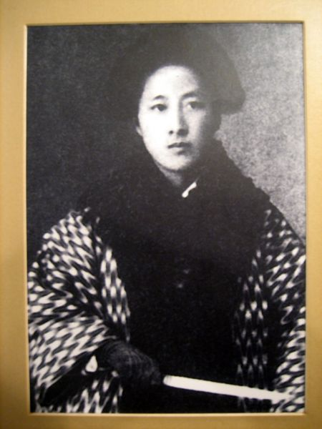
The Women’s Movement
Anti-foot binding movement
Access to modern education
By 1910, forty thousand girl’s schools
By 1919, 134,000 schools with 4.5 million students
Primarily urban
Qui Jin & Chinese Women’s Journal

Slide 29
Reunification by the Nationalists
After death of Yuan Shi-Kai, Sun restructured the KMT in 1919
Due to Western indifference and betrayal, Sun looks to Russia as model for political change
Comintern sends advisors & financial assistance to China
Michael Borodin drafts constitution for Nationalist Party
Comintern helps train KMT forces leading to establishment of Whampoa Military Academy
Notes:
Sun restructured the KMT in 1919 in Guangzhou after returning to China.In 1924, with Soviet support and the help of Michael Borodin, the KMT was reorganized along Leninist lines, becoming a centralized, disciplined revolutionary party.

Slide 30
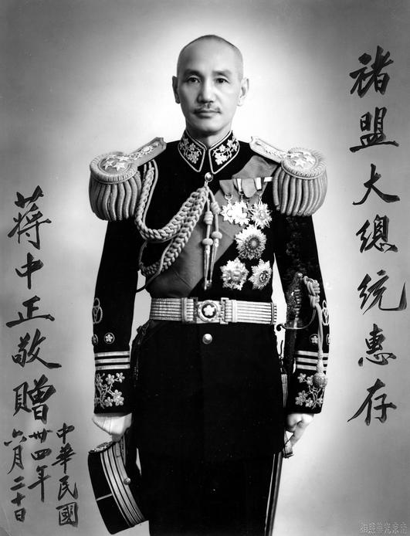
Reunification by the Nationalists
Chiang Kaishek appointed Commandant of Whampoa Academy
1923 – First United Front
Pragmatic alliance between KMT and CCP
Sun did not full embrace communism, but agreed to gain Soviet aid
July, 1926 – Northern Expedition
Defeat Warlords
End foreign domination and imperialists privileges
Unify China under KMT leadership

